Slide 1



Thesis Proposal Defense
Design of an Integrated Modular Motor Drive (IMMD) for Traction Applications
Mesut Uğur
Department of Electrical and Electronics Engineering
Middle East Technical University
xx.05.2018
Supervisor: Asst. Prof. Dr. Ozan Keysan

Slide 2
Outline
Motivation
Literature survey
Projects
Research work
Prototype design
Future work

Slide 3
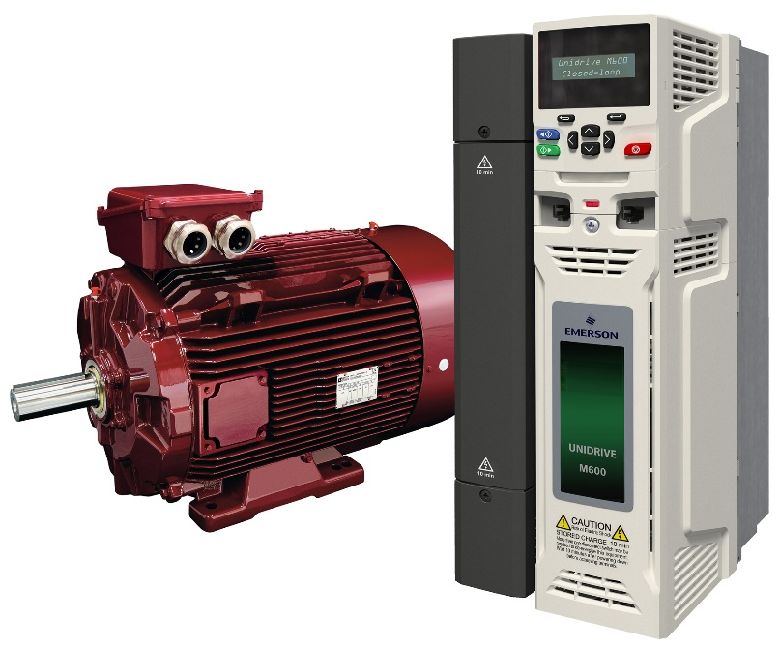
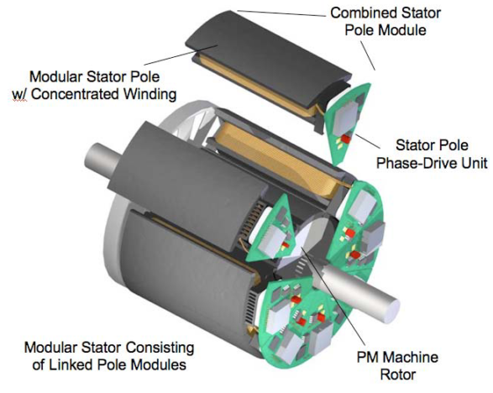
What is IMMD?
Drives are placed in a separate cabinet
Increased volume, weight and cost
Connection with long cables
Long cable effect, EMI problems
The motor drive is integrated to the motor
Both the motor and the drive are modularized
Increased power density
Reduced cost
Reduced EMI
Fault tolerance
Redundancy
Reduced stress
Brown, N. R., Jahns, T. M., & Lorenz, R. D. (2007). Power Converter Design for an Integrated Modular Motor Drive. Industry Applications Conference, 2007. 42nd IAS Annual Meeting. Conference Record of the 2007 IEEE, 1322–1328.

Slide 4
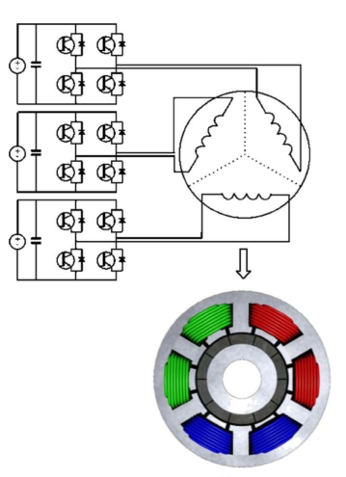
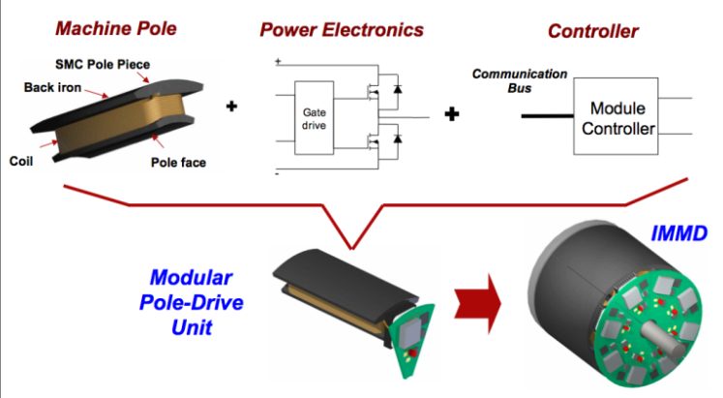
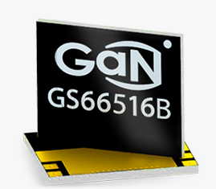
What is IMMD?
Integrated Modular Motor Drive
Challenges
Size reduction
Thermal management
Vibration
Shea, A., & Jahns, T. M. (2014). Hardware integration for an integrated modular motor drive including distributed control. In 2014 IEEE Energy Conversion Congress and Exposition (ECCE) (pp. 4881–4887). IEEE.
Marz, M., Schletz, A., Eckardt, B., Egelkraut, S., & Rauh, H. (2010). Power electronics system integration for electric and hybrid vehicles. Integrated Power Electronics Systems (CIPS), 2010 6th International Conference On, 16–18.

Slide 5

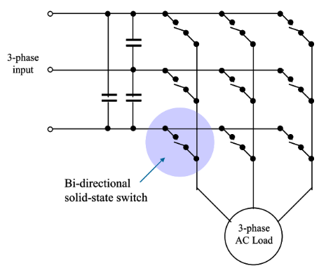
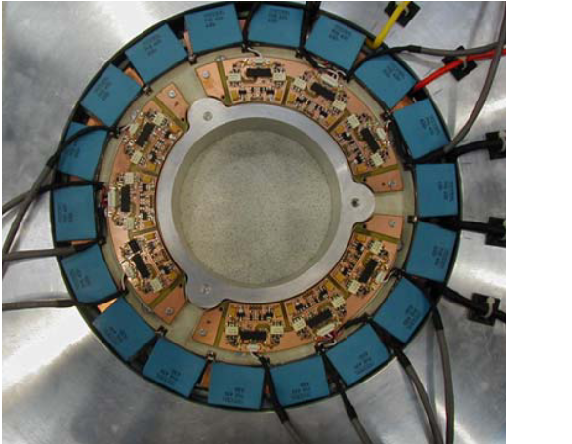
State of the Art
2005, A Fully Integrated 30kW Motor Drive Using Matrix Converter Technology
P W Wheeler, J C Clare, L Empringham, Bradley, S Pickering, D Lampard, K J, M Apap
Targeted at pump and fan applications with induction motor
30 kW prototype, power electronics housed in a re-designed End Plate
Fully tested and evaluated power converter and the cooling arrangements
IGBT based
Wheeler, P. W., Clare, J. C., Apap, M., Empringham, L., Bradley, K. J., Pickering, S., & Lampard, D. (2005). A fully integrated 30 kW motor drive using matrix converter technology. Proc. EPE ’05, 9, 9–16.

Slide 6

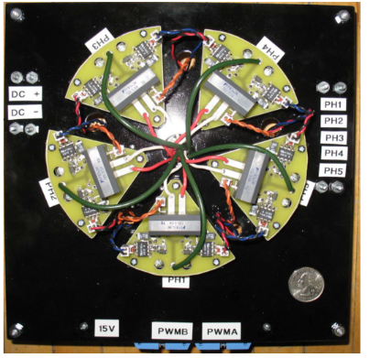
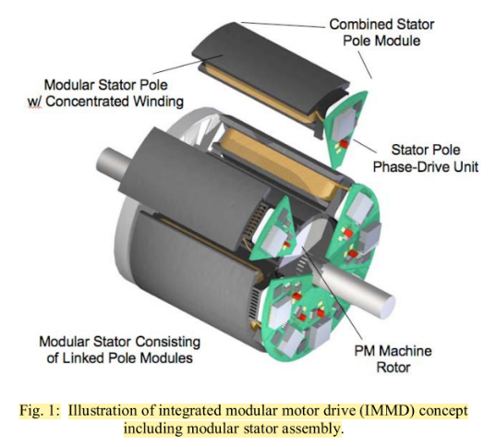
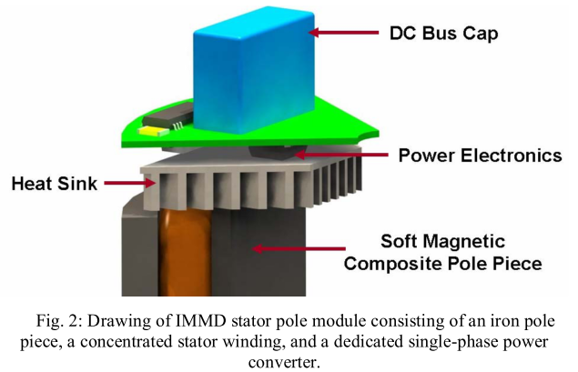
State of the Art
2007, Power Converter Design for an Integrated Modular Motor Drive
N.R. Brown, T.M. Jahns, R.D. Lorenz
Five-phase machine, soft magnetic composite (SMC) material, six-pole PM rotor
Hard-switched half-bridge inverter
2.7 kW output power
IGBT based, 10kHz switching frequency
Brown, N. R., Jahns, T. M., & Lorenz, R. D. (2007). Power Converter Design for an Integrated Modular Motor Drive. Industry Applications Conference, 2007. 42nd IAS Annual Meeting. Conference Record of the 2007 IEEE, 1322–1328.

Slide 7
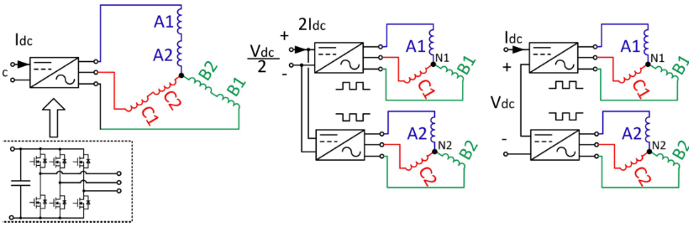
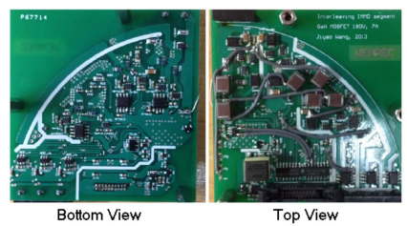
State of the Art
2013, Evaluation and Design for an Integrated Modular Motor Drive (IMMD) with GaN devices
Jiyao Wang, Ye Li, Yehui Han
Series-connected inverter segments
Wide bandgap 200V GaN MOSFETs
Eliminating inverter heat sink
Keep the height of capacitors within 1 inch
Wang, J., Li, Y., & Han, Y. (2013). Evaluation and design for an integrated modular motor drive (IMMD) with GaN devices. 2013 IEEE Energy Conversion Congress and Exposition, ECCE 2013, (Immd), 4318–4325

Slide 8
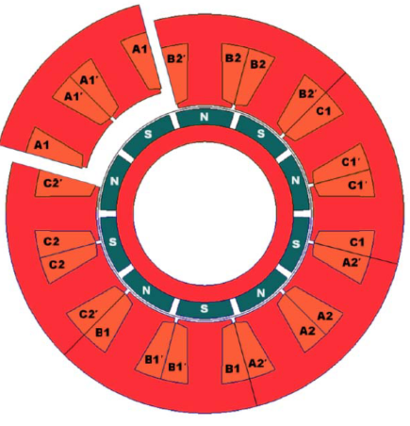
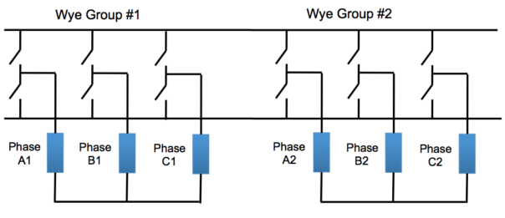
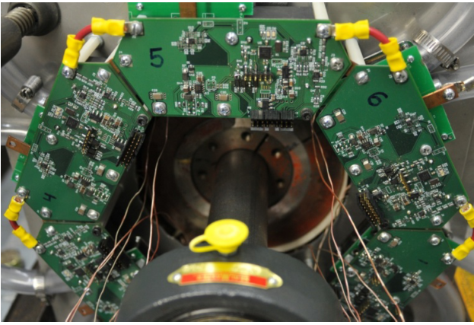
State of the Art
2014, Hardware Integration for an Integrated Modular Motor Drive Including Distributed Control
Adam Shea (Master Thesis), T.M. Jahns
First IMMD prototype unit that included a dedicated controller in each module
18kW (peak), 6-phase IMMD demonstrator unit for a traction drive
Half-bridge inverter for each phase with two discrete 600V IGBTs (20kHz)
10kW six-phase fractional-slot concentrated winding PMSM (12/10).
Shea, A., & Jahns, T. M. (2014). Hardware integration for an integrated modular motor drive including distributed control. In 2014 IEEE Energy Conversion Congress and Exposition (ECCE) (pp. 4881–4887). IEEE.

Slide 9
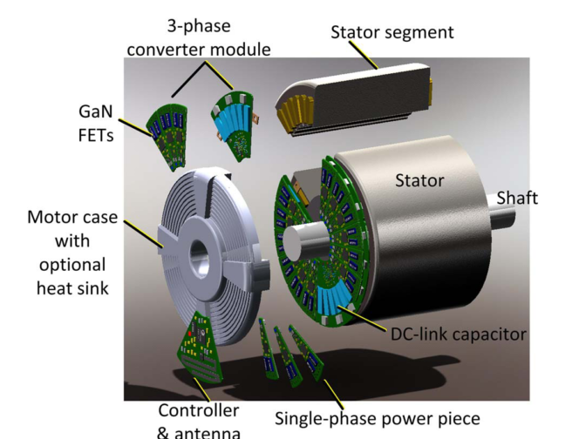
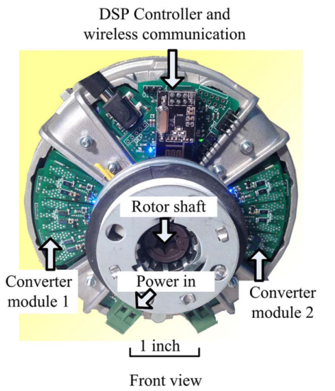
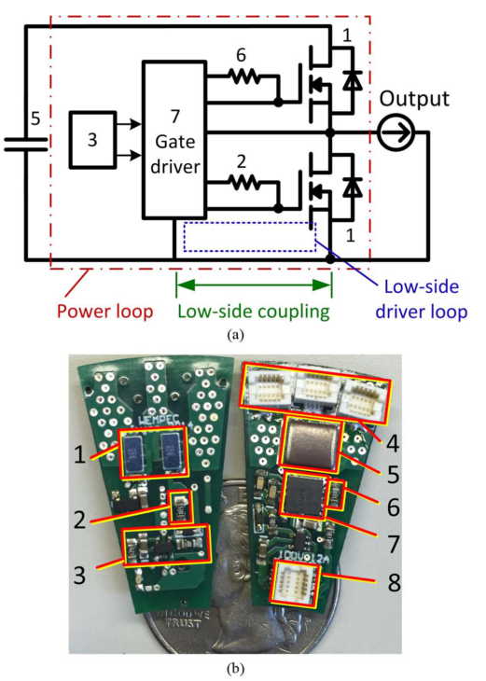
State of the Art
2015, Integrated modular motor drive design with GaN power FETs
Jiyao Wang (PhD Thesis), Ye Li, and Yehui Han
200V EPC GaN FETs, series connected topology, two modules interleaving
36-slot two-pole induction motor reconfigured to six leads
Experiment: Vdc = 200V, n = 2, fsw = 100kHz, Vline = 190V, Iline = 5A
Wang, J., Li, Y., & Han, Y. (2015). Integrated Modular Motor Drive Design With GaN Power FETs. IEEE Transactions on Industry Applications, 51(4), 3198–3207.

Slide 10
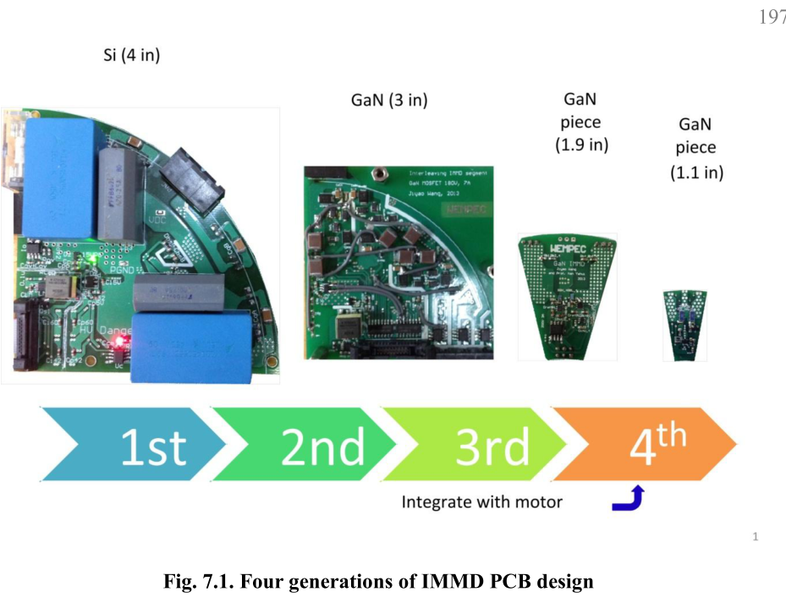
State of the Art
2015, Integrated modular motor drive design with GaN power FETs
Jiyao Wang (PhD Thesis), Ye Li, and Yehui Han
The first generation: The three phase converter module, Si devices, 10 kHz
The second generation: Three phase module design, GaN devices, 50 kHz.
The third generation: A single phase converter piece. GaN devices
The fourth generation: GaN devices, 100 kHz. The overall height 1/4 inch.
Wang, J., Li, Y., & Han, Y. (2015). Integrated Modular Motor Drive Design With GaN Power FETs. IEEE Transactions on Industry Applications, 51(4), 3198–3207.

Slide 11
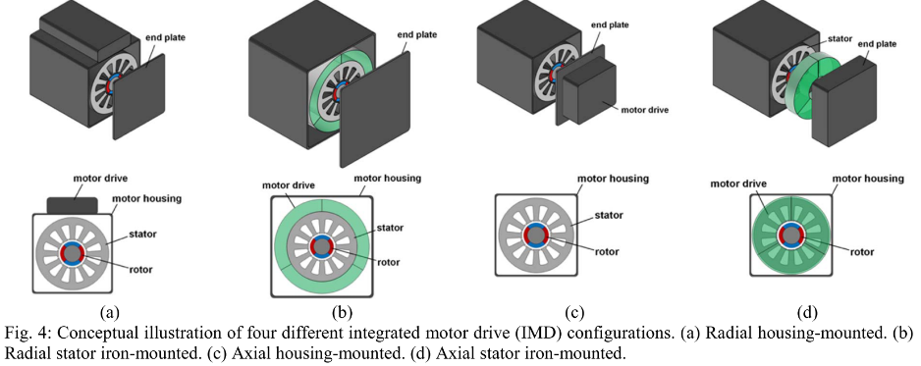
State of the Art
2017, Achieving High-Performance Electrified Actuation System with Integrated Motor Drive and Wide Bandgap Power Electronics
Woongkul Lee, Di Han, Silong Li, Bulent Sarlioglu, Tatiana A. Minav, Matti Pietola
IMD improves power density with 10-20% less volume and reduces 30-40% of the overall system costs of installation and manufacturing.
Lee, W., Li, S., Han, D., Sarlioglu, B., Minav, T. A., & Pietola, M. (2017). Achieving high-performance electrified actuation system with integrated motor drive and wide bandgap power electronics. In 2017 19th European Conference on Power Electronics and Applications (EPE’17 ECCE Europe) (p. P.1-P.10). IEEE

Slide 12
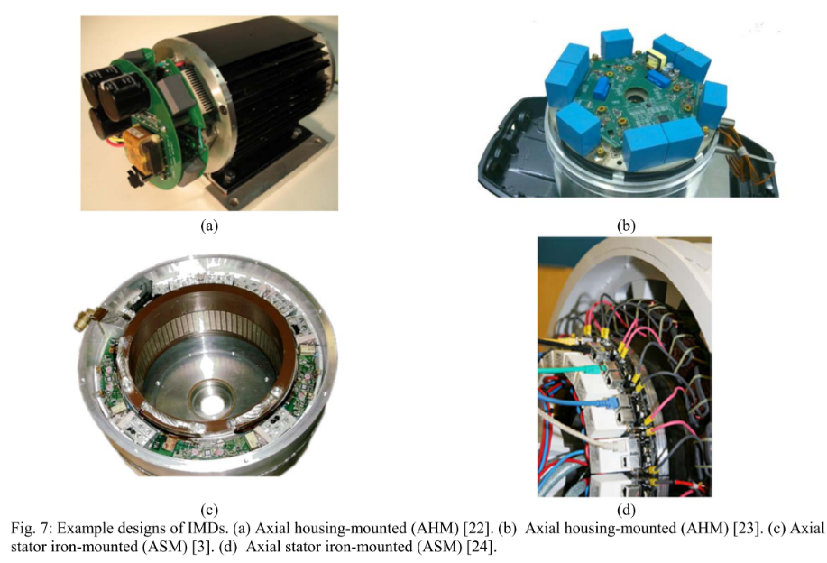
State of the Art
2017, Achieving High-Performance Electrified Actuation System with Integrated Motor Drive and Wide Bandgap Power Electronics
Woongkul Lee, Di Han, Silong Li, Bulent Sarlioglu, Tatiana A. Minav, Matti Pietola
Lee, W., Li, S., Han, D., Sarlioglu, B., Minav, T. A., & Pietola, M. (2017). Achieving high-performance electrified actuation system with integrated motor drive and wide bandgap power electronics. In 2017 19th European Conference on Power Electronics and Applications (EPE’17 ECCE Europe) (p. P.1-P.10). IEEE

Slide 13
Research Opportunities
New generation Wide Band-Gap Power Semiconductor Devices: GaN FETs
Layout design, parasitics modeling and minimization
Size reduction, passive component design and optimization
Modular motor drive topologies, fault tolerance, interleaving
Fault tolerant electrical machines, split winding machines
Vibration effects and minimization
Thermal design and analysis
Filter design with planar magnetics

Slide 14
Funded Projects
METU – BAP
Name: Gan Tabanlı Bir Tümleşik Modüler Motor Sürücü (IMMD) Tasarımı ve Geliştirilmesi
Number: BAP-03-01-2017-004
Budget: 18,500.00 TL
TÜBİTAK - ARDEB 3501
Name: 7.5 kW Sabit Mıknatıslı Tümleşik Modüler Motor Sürücü Sistemi Geliştirilmesi
Number: 117E252
Budget: 151,423.00 TL

Slide 15
What we have done so far
Research on DC Link capacitor minimization
Research on modular motor drive topologies
Research on GaN modeling and switching characteristics
Multi-physics modeling and optimization
IMMD system design with series/parallel connected modules
Design of a modular Permanent Magnet Synchronous Motor
Design of a 4-module motor drive PCB
Prototype design of the IMMD

Slide 16
Publications
DC Link Capacitor Optimization for Integrated Modular Motor Drives
IEEE 26th International Symposium on Industrial Electronics (ISIE 2017)
Tümleşik Modüler Motor Sürücü Sistemi Tasarımı
Ulusal Enerji Dönüşümü Kongresi (EL-EN 2017)
Multi-physics design optimization of a GaN based integrated modular motor drive system
The 9th International Conference on Power Electronics, Machines and Drives (PEMD 2018)
Investigation of Turn-on and Turn-off Characteristics of Enhancement-Mode GaN Power Transistors
20th European Conference on Power Electronics and Applications (Energy Conversion Conference and Exhibition) (EPE 2018)
Comparison of Inverter Topologies Suited for Integrated Modular Motor Drive Applications
18th International Conference on Power Electronics and Motion Control (PEMC 2018)
Design of a GaN Based Integrated Modular Motor Drive
The International Conference on Electrical Machines (ICEM 2018)

Slide 17
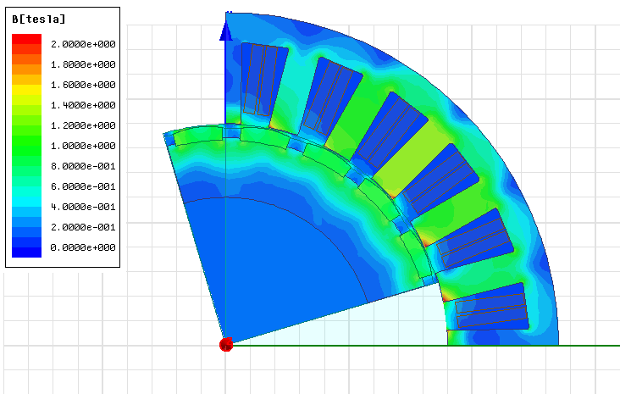
Prototype design
Fractional Slot Modular PMSM
24 slot / 20 pole PMSM with NdFe45 magnets
8 kW output power, 600 rpm
4 x 3-phase modules
> 96% efficiency

Slide 18
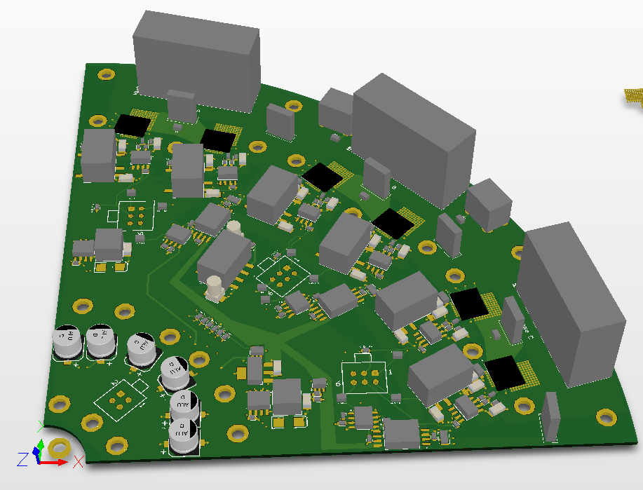
Prototype design
Modular motor drive PCB
650V, 30A E-mode GaNs
4 modules: 2-series and 2-parallel
> 98% efficiency

Slide 19
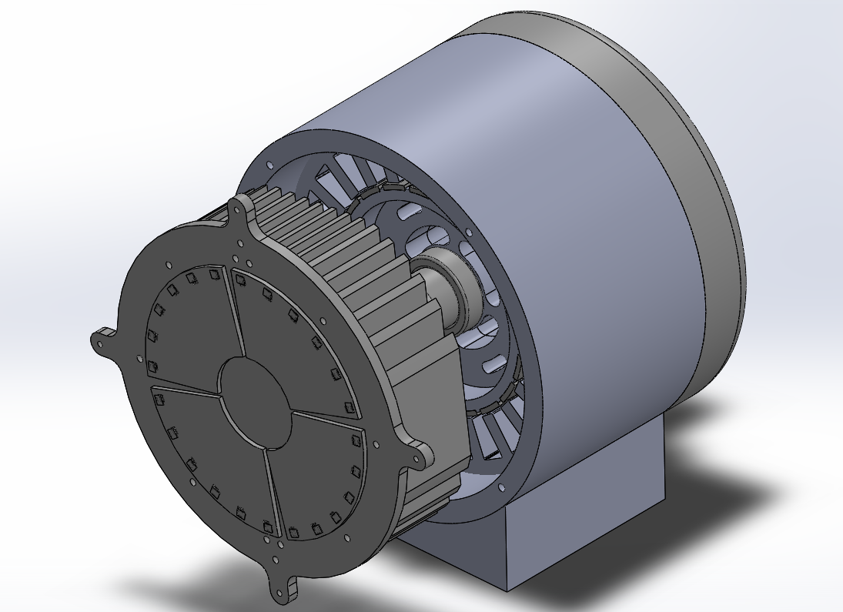
Prototype design
Structural design

Slide 20
Future work

Slide 21
References
Brown, N. R., Jahns, T. M., & Lorenz, R. D. (2007). Power Converter Design for an Integrated Modular Motor Drive. Industry Applications Conference, 2007. 42nd IAS Annual Meeting. Conference Record of the 2007 IEEE, 1322–1328.
Shea, A., & Jahns, T. M. (2014). Hardware integration for an integrated modular motor drive including distributed control. In 2014 IEEE Energy Conversion Congress and Exposition (ECCE) (pp. 4881–4887). IEEE.
Marz, M., Schletz, A., Eckardt, B., Egelkraut, S., & Rauh, H. (2010). Power electronics system integration for electric and hybrid vehicles. Integrated Power Electronics Systems (CIPS), 2010 6th International Conference On, 16–18.
Wheeler, P. W., Clare, J. C., Apap, M., Empringham, L., Bradley, K. J., Pickering, S., & Lampard, D. (2005). A fully integrated 30 kW motor drive using matrix converter technology. Proc. EPE ’05, 9, 9–16.
Wang, J., Li, Y., & Han, Y. (2013). Evaluation and design for an integrated modular motor drive (IMMD) with GaN devices. 2013 IEEE Energy Conversion Congress and Exposition, ECCE 2013, (Immd), 4318–4325
Wang, J., Li, Y., & Han, Y. (2015). Integrated Modular Motor Drive Design With GaN Power FETs. IEEE Transactions on Industry Applications, 51(4), 3198–3207.
Lee, W., Li, S., Han, D., Sarlioglu, B., Minav, T. A., & Pietola, M. (2017). Achieving high-performance electrified actuation system with integrated motor drive and wide bandgap power electronics. In 2017 19th European Conference on Power Electronics and Applications (EPE’17 ECCE Europe) (p. P.1-P.10). IEEE

Slide 22

Thank you !
Mesut Uğur
mesut.ugur@metu.edu.tr
Department of Electrical and Electronics Engineering
Middle East Technical University
power.eee.metu.edu.tr

